Slide 1
HMI Research Group Internship Summer 2017
Long Nguyen (뉀비룡), 한국전자통신연구원

Slide 2
Background
Incoming 3rd-year student at MIT (3학년)
Majoring in Electrical Engineering & Computer Science (MIT 전자컴퓨터과학과)
Experience in systems and software development, UI/UX design
Little/no math background, first experience with ML and NLP

Slide 3
Project Summary Intelligent Gesture Generation Given Input Text
GOAL: Working with the NAO robot, predict speech patterns and generate new gestures that are natural and adaptive (instead of using the predefined gestures).
METHODS: All done in Python, with simulation software (Webots) for data extraction and efficient performance.

Slide 4
Ideal Flow
Prompt user for text input
Input passed to ML model
ML model predicts speech type
Gesture generation based on prediction
NAO reads the text and performs the generated gesture

Slide 5
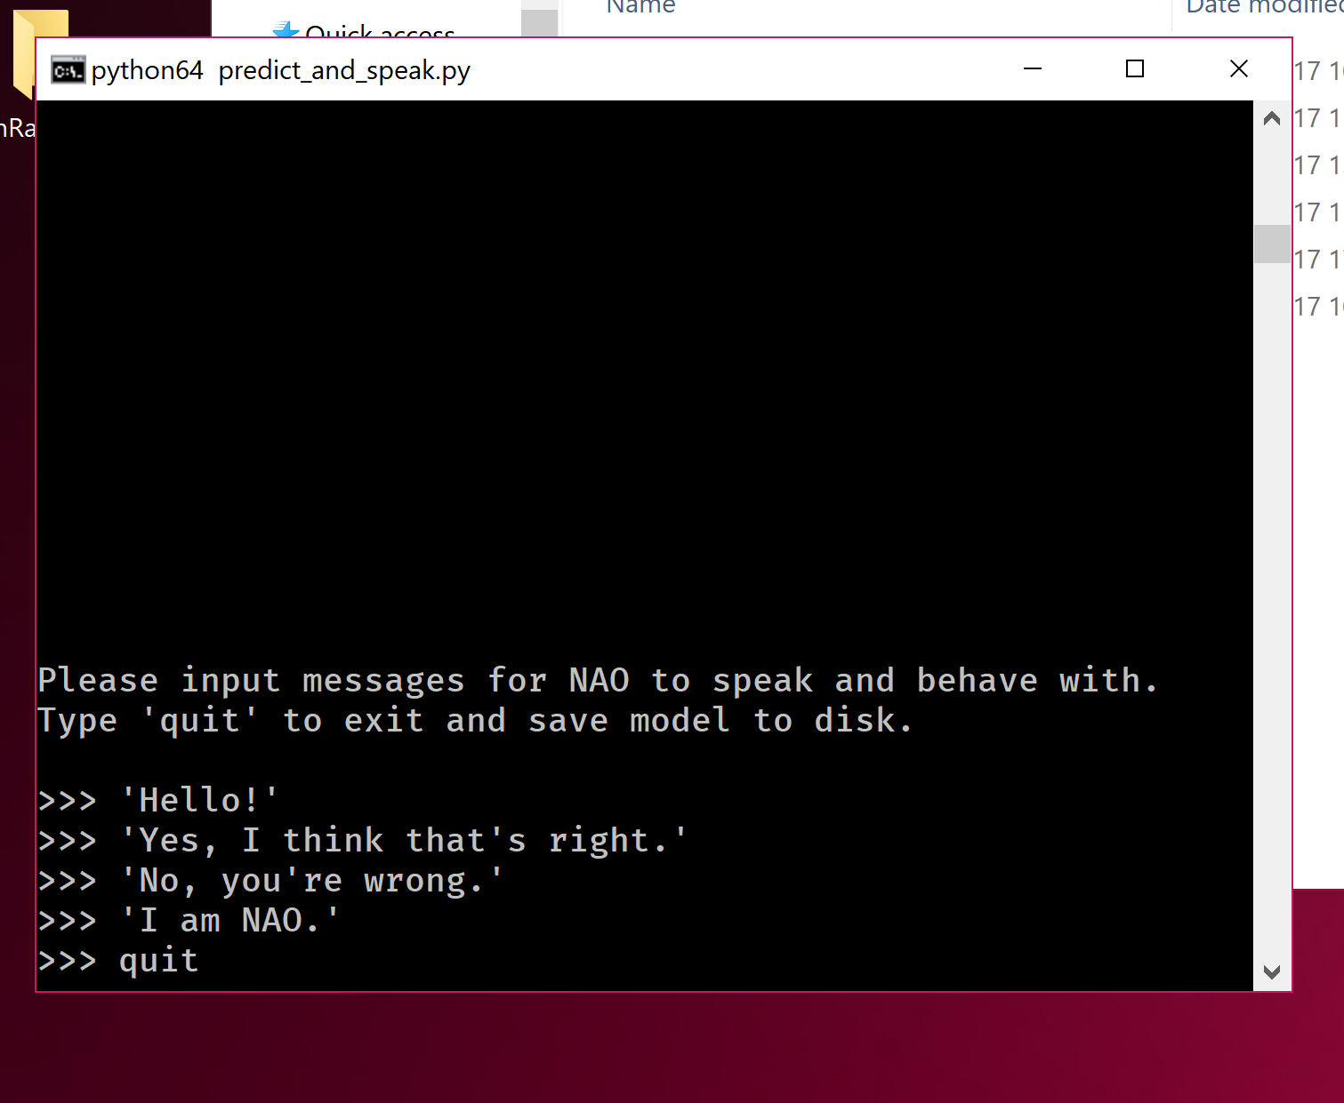
Stage 1: Speech Prediction with Gestures Replicate NAO’s “auto-context” gesture/speech behavior.
Read up on machine learning techniques and theory.
Studied NAO documentation (Python SDK).
Classified the different preinstalled gestures by hand and trained a multilayer perceptron after comparing various models’ performance (SVM, perceptron, etc.).
Developed user console prompt that learns step-by-step and chooses an appropriate gesture for the text.

Slide 6
Stage 1: Speech Prediction with Gestures Replicate NAO’s “auto-context” gesture/speech behavior.
CLASSIFICATION PROBLEM: Given C , the set of 9 categories (described by a keyword—happy, sad, yes, no, etc.) of speech gestures that NAO can perform, we want where w is the to-be-found argument and q is the text that we want NAO to say.

Slide 7
CLASSIFICATION PROBLEM: Given C , the set of 9 categories (described by a keyword—happy, sad, yes, no, etc.) of speech gestures that NAO can perform, we want where w is the to-be-found argument and q is the text that we want NAO to say.
NAIVE METHOD: Using spaCy (Python NLP package), calculate semantic similarity between the keyword and q. Only compares one word to a whole query.
METHOD 2: Use the multilayer perceptron network (mentioned earlier) to predict based off of GloVe vectors (Stanford NLP Group).

Slide 8
Stage 2: Gesture Analysis Study NAO’s motion behavior.
Wrote a script that parses NAO’s sensor data and converts it to proper Numpy arrays for later analysis.
Studied only standing subset of gestures installed on NAO.
BUG: Parser was swapping data between two joints (undetected for almost 2 weeks).
Plotted time series of joint motion for BodyTalk gestures to better understand joint trajectories and patterns (lots of symmetry!)

Slide 9
Stage 2: Gesture Analysis Study NAO’s motion behavior.
Notes:
Lots of symmetric movement can be seen here.

Slide 10
Stage 3: Gesture Generation Generate new, stochastic behavior from gesture data.
FIRST ATTEMPT: Record all sensor data from all gestures of a category, then pick arbitrary values from the data distribution (based on frequency).

Slide 11
Stage 3: Gesture Generation Generate new, stochastic behavior from gesture data.
SECOND ATTEMPT: Filter only for similar-looking gestures to better generate new data, and pick statistically-likely trajectories.
Worked much better, with good, accurate generation for you and yes gesture categories in simulation.

Slide 12
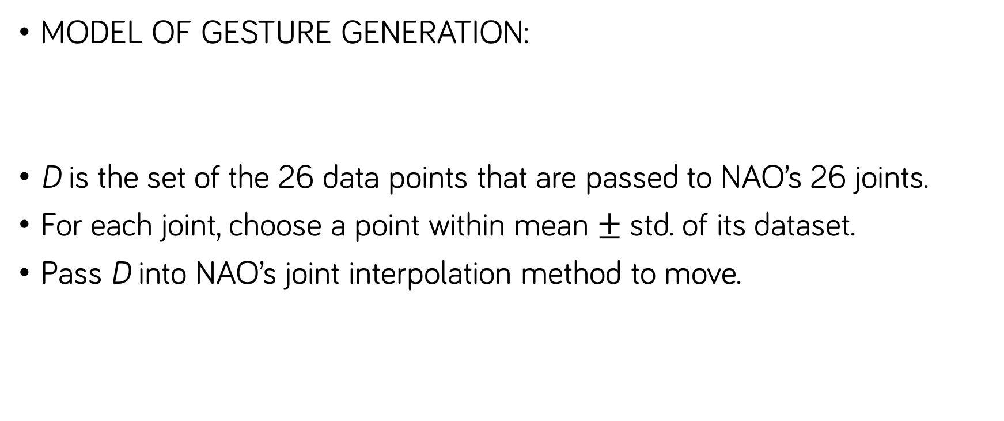
Stage 3: Gesture Generation Generate new, stochastic behavior from gesture data.
MODEL OF GESTURE GENERATION:
D is the set of the 26 data points that are passed to NAO’s 26 joints.
For each joint, choose a point within mean $±$ std. of its dataset.
Pass D into NAO’s joint interpolation method to move.

Slide 13
Stage 4: Integration with Speech Speak while generating motions.
GOAL: Run the speech prediction module together with the gesture generation module to predict text and have NAO generate new behavior at the same time.
RESULT: Cross-compatibility between libraries and 32-bit/64-bit support made it impossible to glue all the pieces together.

Slide 14
Simulation vs. Reality
NAO performance is very lacking vs. simulated Webots.
CPU-dependent, overheating, and long latency delays.
Generating gestures vs. manually-coded gestures. Not simple.

Slide 15
Further Investigation
The project was done only with preimplemented libraries.
Other methods involve more advanced ML theory and formal problem statements, difficult with little background.

Slide 16
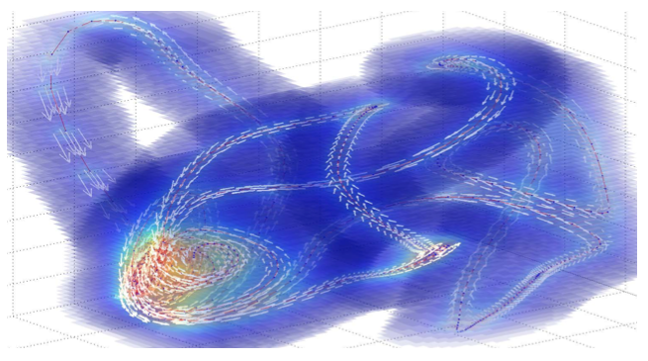
Further Investigation Lower-dimensional manifold embedding
Downsample the 26D NAO data to a manifold, follow low-dimensional trajectory and construct new motions back to 26D.
Downsampling successful (Python library), but reconstruction is very difficult.

Slide 17
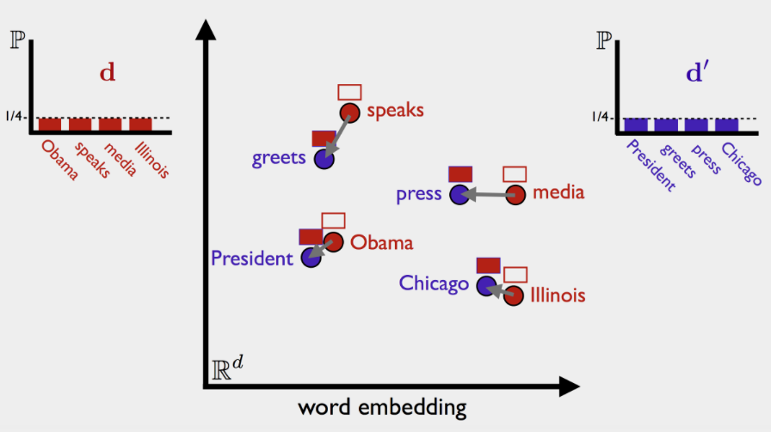
Further Investigation WMD (Word Mover’s Distance)
Proposed semantic comparison classification that works better than many other methods.
Based on “how far” it takes to travel from one word to another word.

Slide 18
Thanks to
기회 준 HMI Research Group
가르친 윤영우 연구원님
같이 있는 인턴: 이준환, 신원철, 김종원

